Slide 1
Imperfect Forward Secrecy
How Diffie-Hellman Fails in Practice
David Adrian, Karthikeyan Bhargavan, etc.
Presented by Eunyoung Cho

Slide 2


What does security depend on?
These objects embed some cryptography.
Protocols includes various kinds of primitives.
  Symmetric cryptography (AES, …)
  Hash functions (md5, SHA-1, SHA-3,…)
  Public-key cryptography (RSA, DSA,...)

Slide 3
Various fields of study
Cryptographic protocols
Implementation of cryptographic software
Auditing implementations
Scrutiny of cryptographic primitives
Oppositely…
Breaking a public-key cryptographic primitive by solving a mathematical problem

Slide 4
Goals
Breaking a public-key cryptographic primitive
Usual measurement unit is public key size
When key size grows
  The mathematical problem is harder to solve.
  The hardness of the mathematical problem depends on the algorithm used.
  Legitimate computation is less efficient.
A compromise is to be found when deploying public-key cryptography.

Slide 5
Diffie-Hellman 1976
Short review of Diffie-Hellman using a Video clip (< 3min)
Public Parameters
  p : a prime
  g : < p group generator (often 2 or 5)

Slide 6
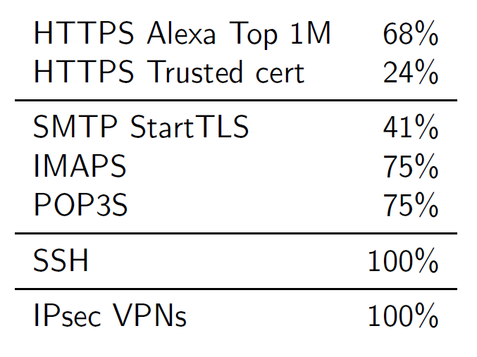
DHKE is extremely common on the internet
Protocol support for “mod p” Diffie-Hellman in Spring 2015 was

Slide 7
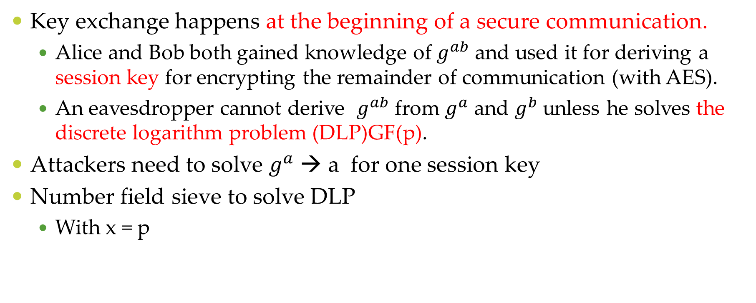
What is key exchange useful for?
Key exchange happens at the beginning of a secure communication.
  Alice and Bob both gained knowledge of $g^{ab}$ and used it for deriving a session key for encrypting the remainder of communication (with AES).
  An eavesdropper cannot derive $g^{ab}$ from $g^{a}$ and $g^{b}$ unless he solves the discrete logarithm problem (DLP)GF(p).
Attackers need to solve $g^{a}$ → a for one session key
Number field sieve to solve DLP
  With x = p

Slide 8

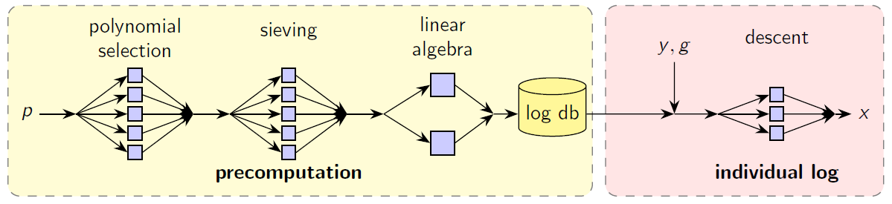
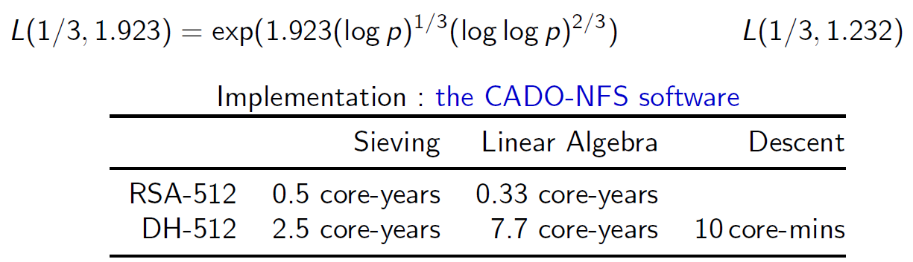
The Number Field Sieve
Goal : given , find x

Slide 9

Key Size
Key exchange uses Diffie-Hellan : DHE or ECDHE
For DHE, primes are
Internet-wide scan of HTTPS servers using Zmap
  14.3M hosts, 24% support DHE
  70,000 distinct groups (p,g)
Composite-order groups with short exponents
  4800 groups where (p-1)/2 was not prime
  Got prime factors for 750 groups on 40K connection
  Some servers used short exponents : 128/160 bits
  Used Pohlig-Hellman to compute
    Full secret exponent for 159 servers
    Partial exponent for 460 servers

Slide 10
Key Size – Small-sized safe primes
Of the Top 1M sites that support DHE in HTTPS
  84% (2.9M) servers uses a 1024-bit or smaller group
    With 94% of these using one of five groups
  2.6%(90K) servers use 768-bit primes.
  0.0008% (2.6K) servers use 512-bit primes

Slide 11
Key Size : what about 512-bit keys?
TLS 1.0 supported weakened ciphers to comply with export regulations in 1990s.
  DHE_EXPORT groups limited to 512 bits key.
  Computation is easy.
  This is never the preferred choice in a TLS connection
  However….
  …but only when client asks for it.

Slide 12
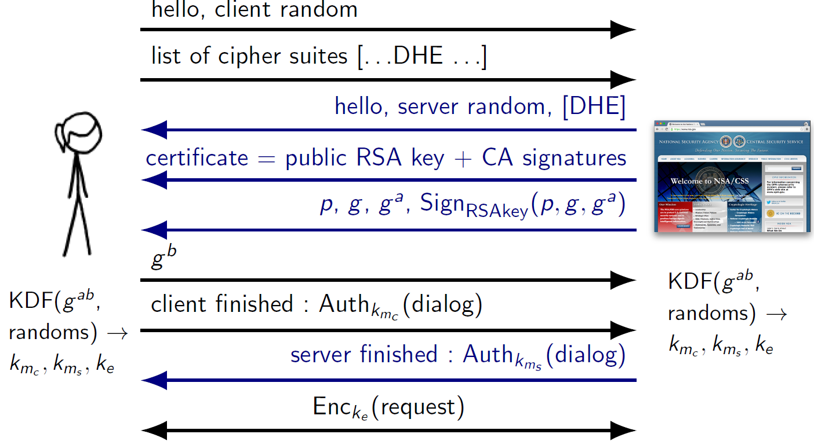
Diffie-Hellman TLS Handshake

Slide 13

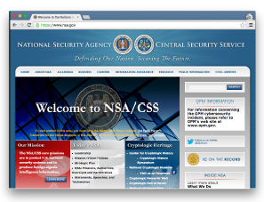

DHE_EXPORT
DHE_EXPORT handshake looks just like DHE
  Server uses same long-term signing key for both
  Difference is prime-size, which clients don’t check
  Opens the way to a downgrade attack

Slide 14
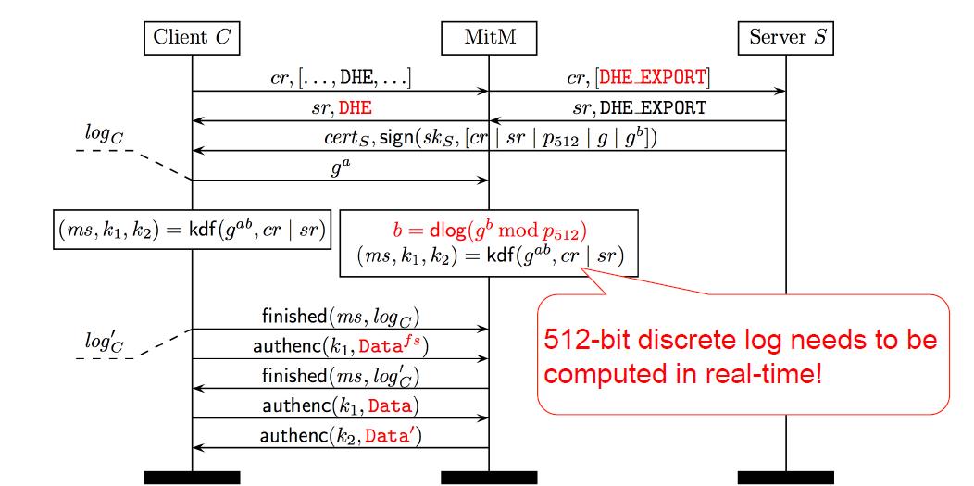
Logjam
Active TLS MITM downgrade attack to 512 bit export DHE
Protocol flaw : Server does not sign chosen cipher suite.

Slide 15
Logjam
Downgrade to DHE_EXPORT
A man-in-the-middle attacker can
  Impersonate any server that supports DHE_EXPORT
  At any client that accept 512-bit DHE groups
Export cipher suites in TLS
  TLS_RSA_EXPORT_WITH_RC4_40_MD5
  TLS_RSA_EXPORT_WITH_RC2_CBC_40_MD5
  TLS_RSA_EXPORT_WITH_DES40_CSC_SHA
  TLS_DH_RSA_EXPORT_WITH_DES40_CSC_SHA
  TLS_DHE_DSS_EXPORT_WITH_DES40_CSC_SHA
  TLS_DHE_RSA_EXPORT_WITH_DES40_CSC_SHA
  ……..

Slide 16
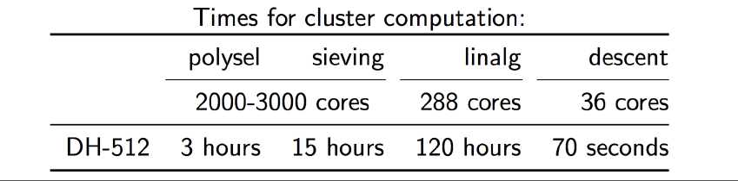
Computing 512-bit discrete logs
Carried out precomputation for Apache, mod_ssl primes.
After 1 week precomputation,
  Per-connection descent computation: 30-150 sec
  Median individual log time is 70 sec

Slide 17
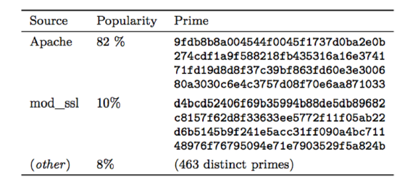
Most hosts use the same parameters
Parameters hard-coded in implementations or built into standards.
92% of DHE_EXPORT host choose one of two 512-bit primes.
Top ten primes accounted for 99% of DHE_EXPORT-tolerant hosts.

Slide 18

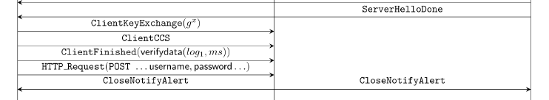
Logjam – Exploiting False Start
Some web browsers start sending data too early
  To optimize TLS performance for PFS ciphersuites
No need to wait up to 150 sec for DLP
Logjam can capture this early application data and compute DLP at leisure to read password/cookies
  …..

Slide 19
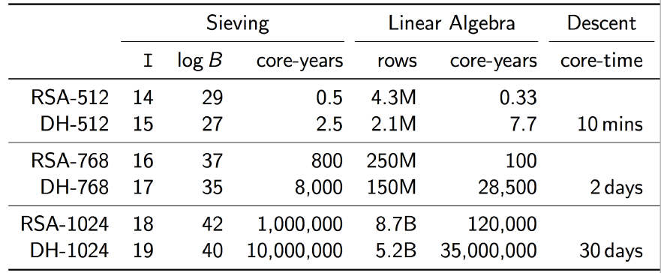
Cost estimates for bigger groups
For DHE_EXPORT connections
  Connections between Chrome/Firefox/IE and 8.4% of websites can be broken offline( no forward secrecy)
For regular DHE, they need to break bigger groups
  For academics, probably need to algorithmic improvements
  For governments, 768 bits is definitely reachable.

Slide 20
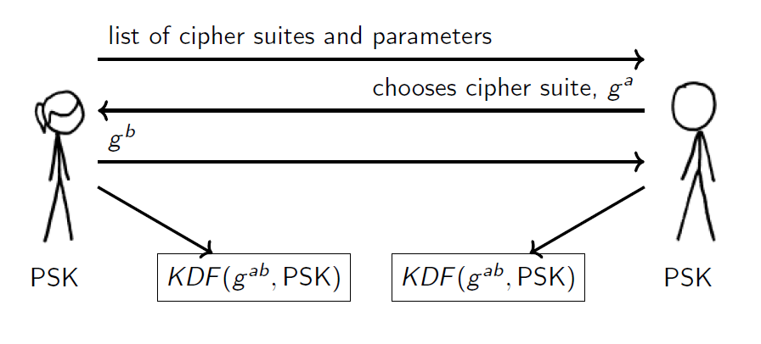
Decrypt the VPN traffic?
IKE key Exchange for VPNs/IPsec
  IKE chooses Diffie-Hellman parameters from standardized set.

Slide 21
Decrypt the VPN traffic?
Find pre-Shared Key
Locate complete paired collect
Locate both IKE and ESP traffic
Have collection sites do surveys for the IP’s
Find better quality collect with rich metadata
Refer to NSA VPN Attack Orchestration in the paper

Slide 22
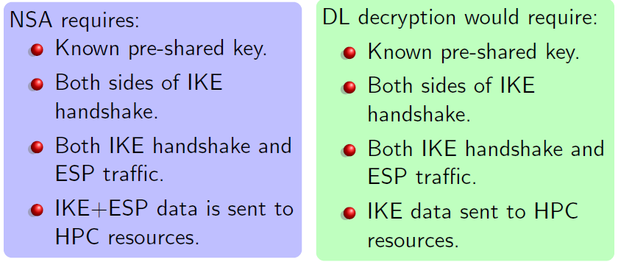
Decrypt the VPN traffic?
It seems plausible!
A 1024-bit DH break is a parsimonious explanation for NSA’s large-scale passive decryption of VPN traffic.
A well-designed “implant” would have fewer requirements.

Slide 23
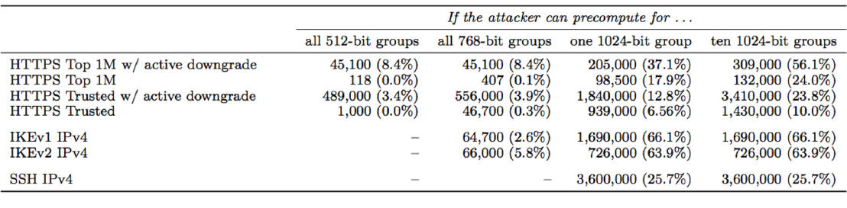
Impact of breaking bigger groups
IKEv1, IKEv2, SSH all use 768-bit/1024-bit groups
  6% of IKEv2 servers use Oakley 1 (768-bits)
  64% of IKEv2 servers use Oakley 2 (1024-bits)
  26% of SSH servers use Oakley 2 (1024-bits)
  13% of HTTPS servers use 1024-bit Apache group

Slide 24
Parameter reuse for 1024-bit Diffie-Hellman
Precomputation for a single 1024-bit prime allows passive decryption of connections to 66% of VPN servers and 26% of SSH servers
in Oakley Group 2
Precomputation for a second common 1024-bit prime allows passive decryption for 18% of top 1M HTTPS domains
in Apache 2.2

Slide 25
Solutions
Logjam Mitigation
  Security updates to major TLS libraries, web browsers, websites, mail servers
    Disable 512-bit, then 768-bit, then 1024 bit
    They recommend 2048-bit safe primes
    Major browsers have raised minimum DH lengths:
      IE, Chrome, Firefox to 1024 bits
      Safari to 768 bits
  TLS 1.3 draft anti-downgrade mechanism

Slide 26
Solutions
1024-bit discrete log within range for governments
Parameter reues allows wide-scale passive decryption
  Mitigations
    Move to elliptic curve cryptography
    If ECC is not an option, use 2048 bit primes.
    If 2048 bit primes are not an options, generate a fresh 1024 bit prime.

Slide 27
A new protocol: TLS 1.3
Stronger key exchanges, fewer options
  DCDHE and DHE by default, no RSA key transport
  Fixed DH groups (>2047 bits) and EC curves (>255 bits)
  Only AEAD ciphers(AES-GCM), no CBC, no RC4
Signatures, session keys bound to handshake parameters
  Server signature covers ciphersuite (preventing Logjam)
Faster
  Lower latency with 1 round-trip

Slide 28
Questions
Logjam is an active TLS MIMT ( ) Attack to 512-bit DHE ( )-grade cipher suites.
The number field sieve algorithm for discrete log consists of a precomputation stage and an individual log computation stage. What is “four steps” in the stages?
With a decent implementation, the computation takes an average of 70 sec. How can attacker work around this delay?

